Slide 1
Class relationship
Session 7
D6421 – Muhammad Fikri Hasani

Slide 2
Outline
Course outline
Introduction
Association
Aggregation
Composition

Slide 3
Class relationship
Introduction
To design classes, you need to explore the relationships among classes.
Relationships between classes are inevitable if each class uses another class
The common relationships among classes are association, aggregation, composition

Slide 4

Class relationship
Association
Association is a general binary relationship that describes an activity between two classes. An association is illustrated by a solid line between two classes with an optional label that describes the relationship.
For example, a student taking a course is an association between the Student class and the Course class, and a faculty member teaching a course is an association between the Faculty class and the Course class.

Slide 5
Introduction to java programming
Association
Each class involved in an association may specify a multiplicity. Some typical examples of multiplicity:
Multiplicity | Cardinality
0..0 | Collection must be empty
0..1 | No instances or one instance
1..1 | Exactly one instance
0..* | Zero or more instances
1..* | At least one instance
5..5 | Exactly 5 instances
m..n | At least m but no more than n instances

Slide 6
Class relationship
Association
Each student may take any number of courses, and each course must have at least five and at most sixty students. Each course is taught by only one faculty member, and a faculty member may teach from zero to three courses per semester

Slide 7
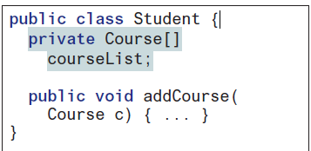
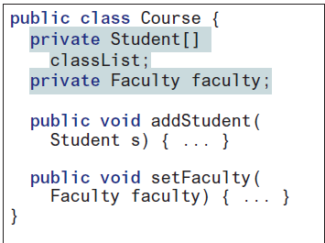
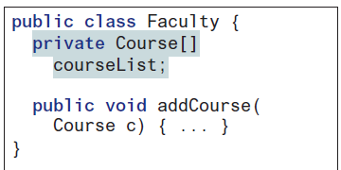
Class relationship
Association
In Java code, you can implement associations by using data fields and methods.
The relation “a student takes a course” is implemented using the addCourse method in the Student class and the addStudent method in the Course class.
The relation “a faculty teaches a course” is implemented using the addCourse method in the Faculty class and the setFaculty method in the Course class.
The Student class may use a list to store the courses that the student is taking
Faculty class may use a list to store the courses that the faculty is teaching
Course class may use a list to store students enrolled in the course and a data field to store the instructor who teaches the course.

Slide 8
Class relationship
Aggregation and composition
While association is modelling the general kinds of relationship between classes, there are 2 special relationship:
Aggregation
Aggregation is a special form of association that represents an ownership relationship between two objects.
Aggregation models has-a relationships. The owner object is called an aggregating object, and its class is called an aggregating class.
The subject object is called an aggregated object, and its class is called an aggregated class
Composition
Aggregation between two objects as composition if the existence of the aggregated object is dependent on the aggregating object
if a relationship is composition, the aggregated object cannot exist on its own
More about part-of relationship (aggregated class is part of aggregating class)

Slide 9
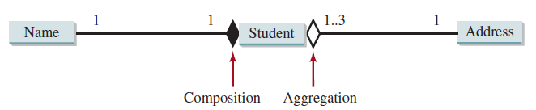
Class relationship
Aggregation and composition
For example:
“a student has a name” is a composition relationship between the Student class and the Name class,
“a student has an address” is an aggregation relationship between the Student class and the Address class, since an address can be shared by several students.

Slide 10
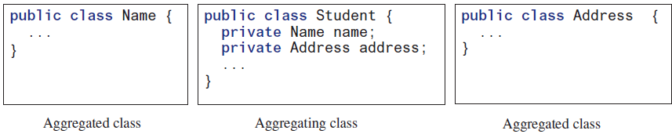
Class relationship
Aggregation and composition
An aggregation relationship is usually represented as a data field in the aggregating class.

Slide 11
Class relationship
Aggregation and composition
An aggregation relationship is usually represented as a data field in the aggregating class.

Slide 12
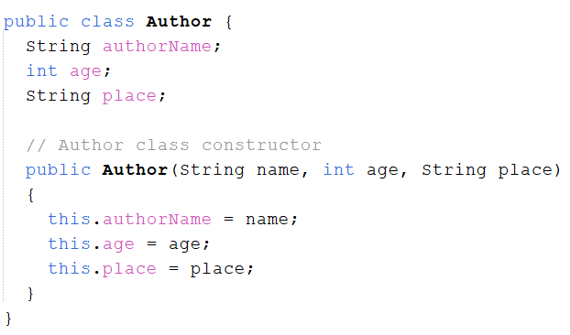
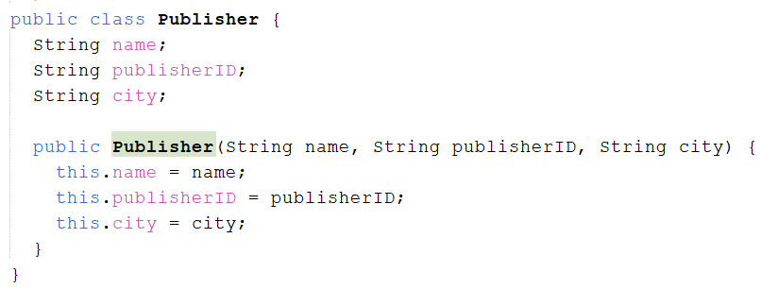
Class relationship
Aggregation example
Aggregation is simpler to define, as each class independent in the lifecycle, while maintain has-a relationship.
Here we will define three classes: Book, Publisher, and Author.
The aggregating class is Book, Aggregated class is Publisher and Author.

Slide 13
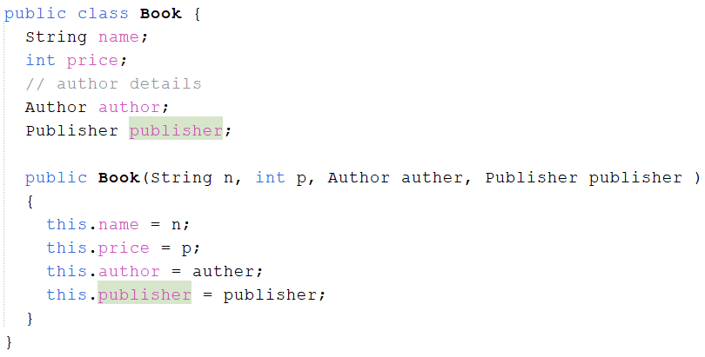
Class relationship
Aggregation example
As we can see, the Author and Publisher class was owned by Book class as data fields. Indicating Has-A relationship

Slide 14
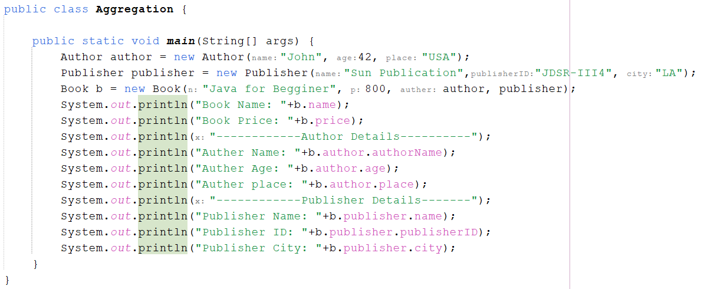
Class relationship
Aggregation example
Because of the independence, each class can be instantiated individually

Slide 15
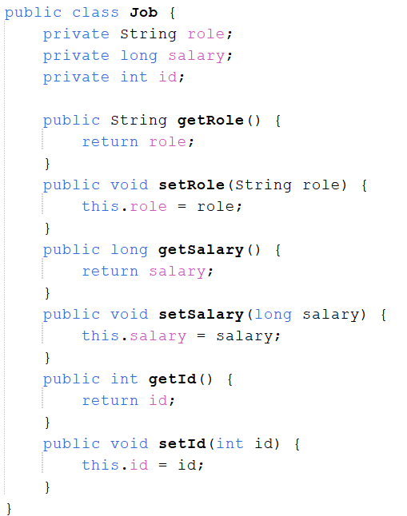
Class relationship
COMPOsition example
While aggregation is simpler to understand (the aggregated class can be independent by itself), composition can be more challenging to be understood.
Example below. Lets say that we have 2 class named Job and Person.
Person need the job class to be exists (instantiated), and the Job class (the aggregated class) wont be instantiated independently by our design.
To achieve this, the job class will be instantiated inside the constructor of person class.
For example, here is the job class

Slide 16
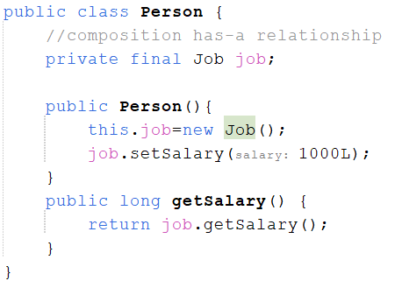
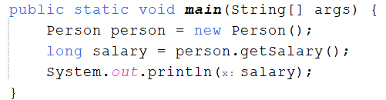

Class relationship
COMPOsition example
The person class is owning the Job class by data field/ attributes
Object of Job class will be instantiated inside the constructor of person class
In our main program, only person class that will be instantiated as an object.
Hence, when person object is instantiated, job object also
instantiated inside.
When person object is destroyed, job object also destroyed

Slide 17
Exercise
Car rent system
In a car rental company:
A Customer can rent a Car, but the Customer can still exist without the Car, and the Car can still exist without the Customer.
The RentalCompany has a list of Cars. If the company shuts down, the cars can be transferred to another company.
Every Car always has an Engine that is created together with the Car. If the Car is destroyed, the Engine is also gone.
Your tasks:
Create the following classes: Customer, Car, Engine, RentalCompany.
Explain the relationships between the classes.
Create a program to simulate the following scenario:
  The RentalCompany named LocalRent has 4 cars.
  Jojo rents 1 car with a gasoline engine.
  Jojo returns the car.
  After that, LocalRent closes, and all the cars are transferred to LocalRent2.

Slide 18
Class relationship
References
Daniel Liang, Introduction to Java Programming and Data Structure, 12th edition.
https://www.digitalocean.com/community/tutorials/composition-in-java-example
https://www.studytonight.com/java/aggregation.php

